Slide 1
Regex Crossword
By Mitchell Clay, Cody Mace, Roth In

Slide 2
What is Regex Crossword?
Regex crossword is a type of puzzle where the crossword clues are regular expressions instead of traditional clues.
The goal is to find the character which satisfies the regular expressions of that row and column.

Slide 3
What is Regex Crossword?
Puzzles can be in a variety of sizes with different number of rows and columns based on the difficulty level of the puzzle
Support for
2x2
4x4
8x8

Slide 4
What is Regex Crossword?
Support for variety of types of regular expressions
Expressions combine the following to produce an expression
OR
Range of characters
Characters not to include
Zero or more
One or more
Back refences

Slide 5
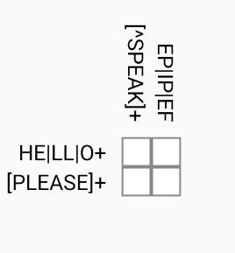
Puzzle example
Examples an easy puzzle:
4 regular expressions total
Solution is:
H | E
L | p

Slide 6
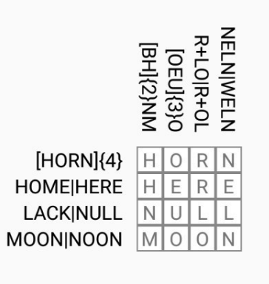
Puzzle example
Examples an medium puzzle:
8 regular expressions total
Solution is:
H | O | R | N
H | E | R | E
N | U | L | L
M | O | O | N

Slide 7
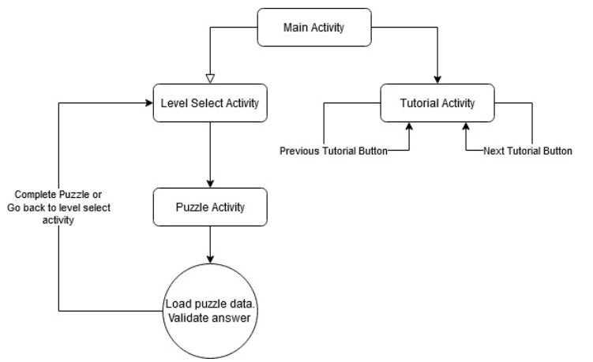
High level overview of APP

Slide 8
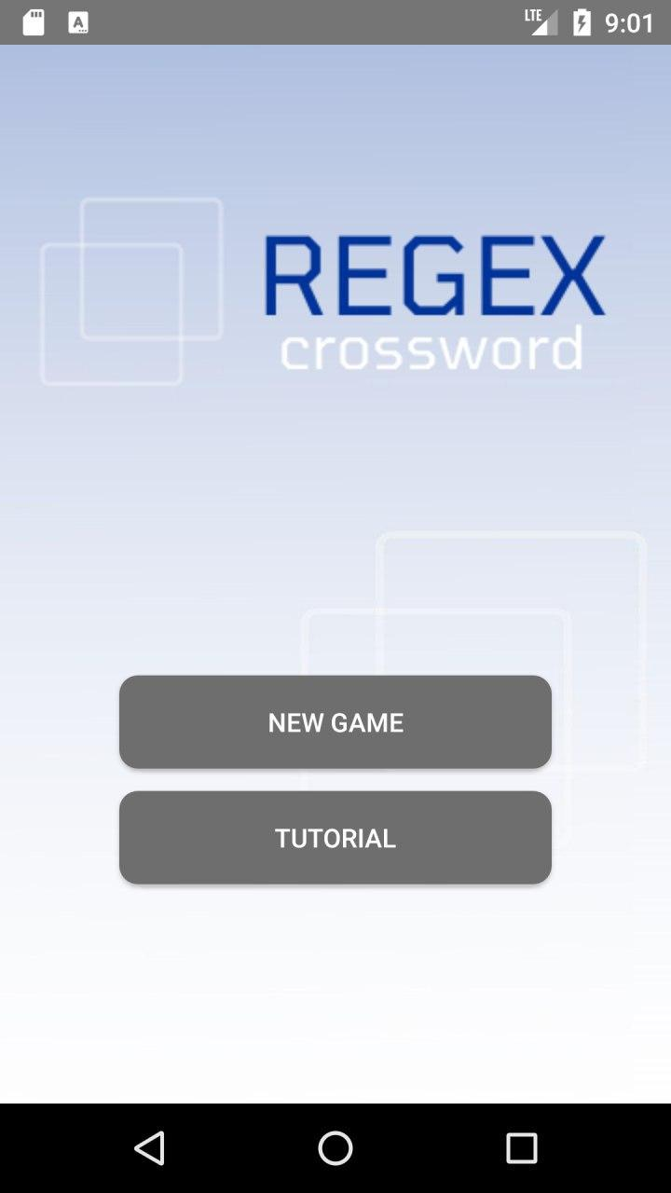
Main activity

Slide 9
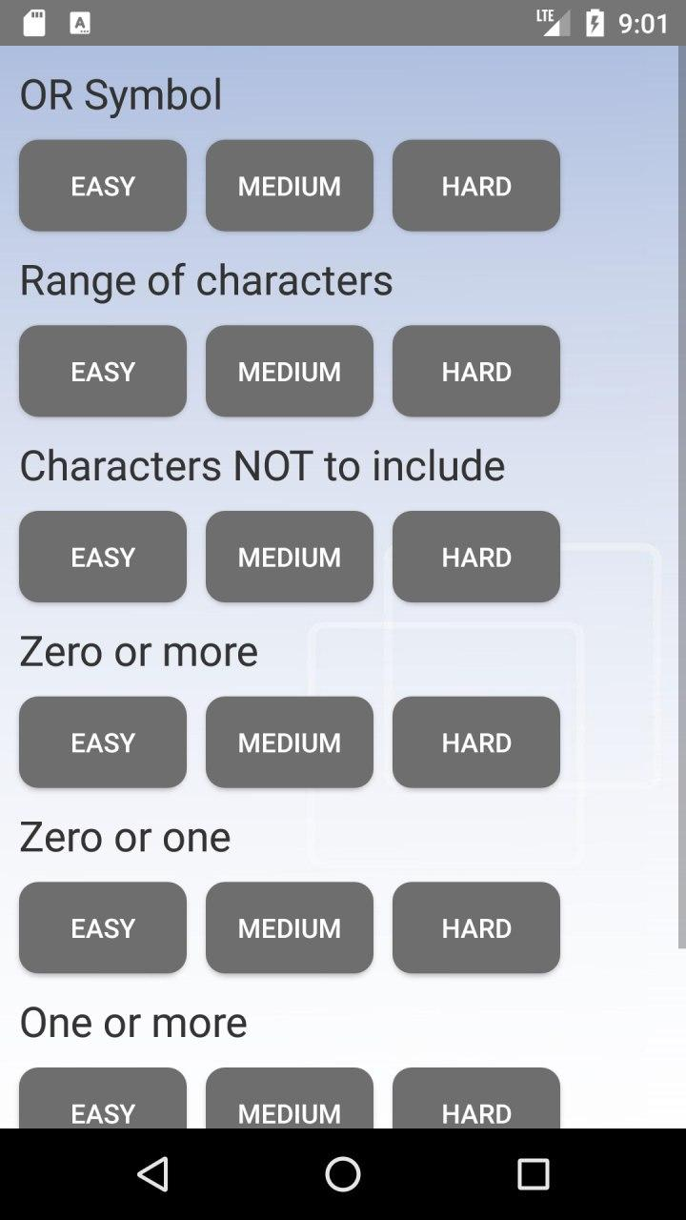
Level Select Activity

Slide 10
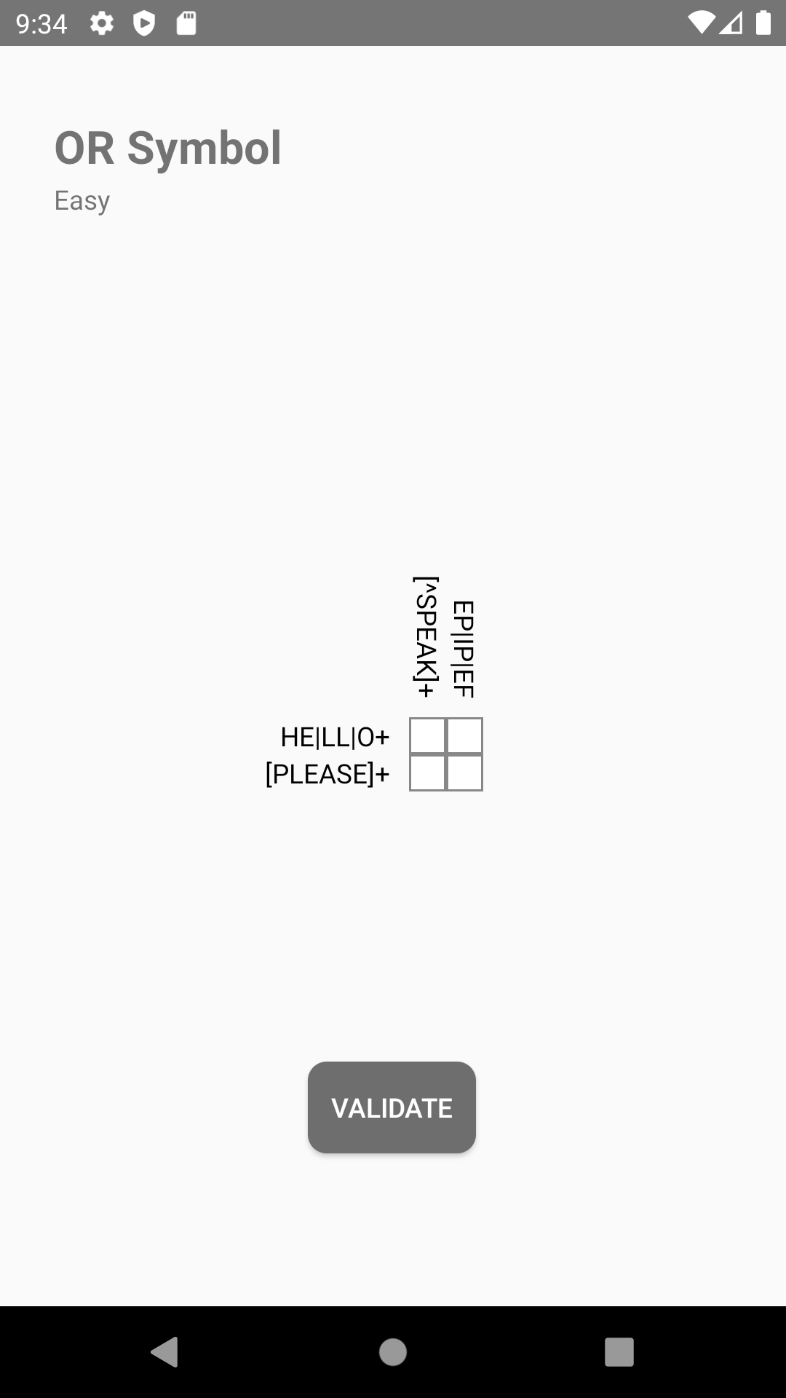
Puzzle activity
Contains the puzzle grid layout
Clicking on a grid opens the letter selection screen
Validate button to check the solution

Slide 11
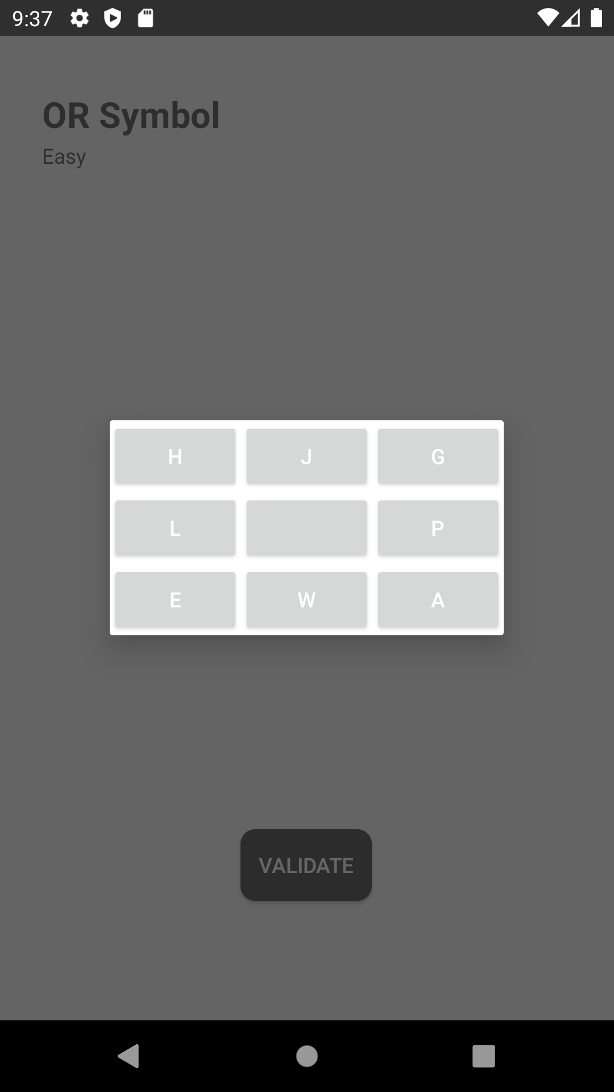
Puzzle activity
Letter choice fragment allows the users to select a letter from a pool of possible letters

Slide 12
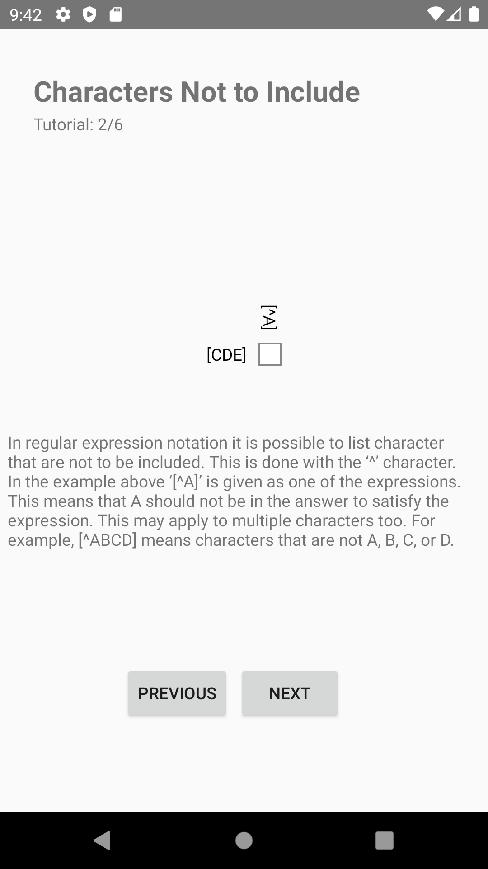
Tutorial activity
Tutorial activity contains guide on how each category of regular expression notation works
Previous and next button to cycle through tutorial

Slide 13
Future work
More puzzles for all the categories
Ability to push puzzles from a webserver so more puzzles can be added without requiring an update to the application
Daily puzzles

